Slide 1






Agricultural Raw Material Analysis
Student Details
Name; Kavin V
NM Id: au9762212203 / E56018E3602AFBDB2B542ECB8F8CC2BF
College Name: Alagappa Chettiar Government College of Engineering and Technology

Slide 2

Course Outline
Abstract
Problem Statement
Aims, Objective & Proposed System/Solution
System Deployment Approach
Model Development & Algorithm
Future Scope
Video of the Project
Conclusion
Reference

Slide 3
Abstract
This study delves into the exploration of agricultural raw material prices through comprehensive data analysis. The dataset, comprising historical records of raw material prices, is subjected to thorough scrutiny to unveil significant insights. By identifying high and low-range materials based on average prices, we gain valuable understanding of the economic landscape. Moreover, analyzing the percentage changes in prices facilitates the identification of materials exhibiting notable fluctuations over time, shedding light on market dynamics. The investigation into the range of price changes further enriches our comprehension of price volatility within the agricultural sector. Additionally, mapping correlations among raw materials offers a nuanced understanding of their interplay and potential implications for pricing strategies. Overall, this exploratory analysis sets the stage for informed decision-making in agricultural economics, providing stakeholders with actionable insights to navigate market uncertainties and optimize resource allocation.

Slide 4
Problem Statement
In the realm of agricultural economics, understanding the dynamics of raw material prices is paramount for effective decision-making and resource allocation. However, the vast array of agricultural raw materials and their fluctuating prices pose a significant challenge for stakeholders.
There exists a need for a comprehensive analysis framework that can systematically explore raw material prices, identify high and low-range materials, analyze percentage changes over time, and uncover correlations between different materials.
This study aims to address this challenge by conducting an exploratory data analysis (EDA) on agricultural raw material prices dataset, ultimately providing stakeholders with actionable insights to navigate market uncertainties and optimize resource allocation strategies.

Slide 5

Aim and Objective
The aim of this project is to conduct an in-depth analysis of agricultural raw material prices dataset through Exploratory Data Analysis (EDA). By examining historical price trends and fluctuations, the project seeks to identify high and low-range raw materials, assess percentage changes in prices to understand market volatility, and explore correlations between different types of raw materials. Ultimately, this analysis aims to provide valuable insights for stakeholders in the agricultural sector to make informed decisions regarding pricing strategies, supply chain management, and risk mitigation.

Slide 6
Objectives
1. Identify Price Trends: Analyze historical data to identify trends in agricultural raw material prices over time, including seasonal variations and long-term price movements.
2. Quantify Price Volatility: Calculate the percentage changes in prices for individual raw materials to assess the level of volatility in the market and understand the extent of price fluctuations.
3. Identify High and Low-range Materials: Determine the raw materials exhibiting the highest and lowest price ranges, providing valuable insights into market dynamics and potential opportunities or risks for stakeholders.
4. Explore Correlations: Investigate the relationships between different types of raw materials through statistical methods such as correlation analysis, aiming to uncover patterns or dependencies that could inform strategic decision-making.
5. Provide Insights for Decision-Making: Offer actionable insights based on the analysis findings to assist stakeholders in making informed decisions regarding pricing strategies, inventory management, and risk mitigation in the agricultural sector.

Slide 7
Proposed Solution
1. Data Preprocessing: Cleanse and preprocess the agricultural raw material prices dataset to handle missing values, outliers, and inconsistencies, ensuring the quality and integrity of the data for analysis.
2. Exploratory Data Analysis (EDA): Conduct comprehensive EDA to examine various aspects of the dataset, including descriptive statistics, distribution of prices, seasonal trends, and correlation between raw materials, providing a holistic understanding of the data.
3. Statistical Analysis: Utilize statistical techniques such as percentage change calculation, price range determination, and correlation analysis to quantify and interpret the patterns and relationships within the dataset, facilitating informed decision-making.
4. Visualization and Reporting: Present the analysis findings through clear and informative visualizations such as plots, charts, and heatmaps, accompanied by detailed reports summarizing key insights and recommendations for stakeholders in the agricultural sector.
Notes:
7

Slide 8
System Deployment Approach
Exploratory Data Analysis (EDA)
Data Collection
Data Preprocessing
Data Collection
Data Collection
Data Collection
Notes:
8

Slide 9
Model Development & Algorithm
:
The dataset contains agricultural raw material price data
Spanning two years from 2023 to 2024
Variables include Year, Material, and Price
Materials include Wheat, Corn, Soybeans, Rice, Sugar Cane, Cotton, Barley, and Potatoes
Each material has price data recorded for all three years
Notes:
9

Slide 10
Model Development & Algorithm
Utilized historical price data of agricultural raw materials to develop predictive models for forecasting future prices.
Choose suitable algorithms such as time series forecasting models (e.g., ARIMA, SARIMA, Prophet) or regression models (e.g., Linear Regression, Random Forest Regression, Gradient Boosting Regression).
Leverage insights from exploratory data analysis (EDA) to inform feature selection and model training processes, ensuring alignment with observed patterns and trends.
Evaluated the model performance using established metrics like Mean Absolute Error (MAE), Mean Squared Error (MSE), or Root Mean Squared Error (RMSE), alongside cross-validation techniques to validate predictive accuracy.
Visualized model predictions alongside actual price data, facilitating interpretation and communication of forecasted trends to stakeholders, enabling informed decision-making in agricultural markets.
Notes:
10

Slide 11
Result
Identified top 10 materials with the highest and lowest prices, providing insights into market valuation and potential investment opportunities or risks.
Calculated percentage changes in prices for each material, highlighting materials with significant price fluctuations over time, guiding strategic decision-making for stakeholders.
Analyzed price changes over the years, revealing trends and variations in prices across different materials, aiding in understanding market dynamics and planning future strategies.
Investigated correlations between numerical variables, revealing potential relationships and dependencies between agricultural materials, facilitating risk management and portfolio diversification strategies.
Leveraged insights from exploratory data analysis to develop predictive models for forecasting future prices, enabling stakeholders to anticipate market trends and make informed decisions in the agricultural sector.
Notes:
11

Slide 12
Future Scope
Enhance predictive models for more accurate forecasting of agricultural raw material prices using advanced machine learning techniques.
Incorporate additional external factors like weather patterns and geopolitical events to improve model robustness and capture broader market influences.
Integrate real-time data feeds to update the dataset continuously, enabling dynamic model recalibration and timely decision-making.
Extend analysis to specific agricultural sectors for tailored insights, addressing unique challenges and opportunities within each sector.
Develop decision support systems for stakeholders, providing actionable insights and recommendations for strategic planning and risk management in the agricultural industry.
Notes:
12

Slide 13
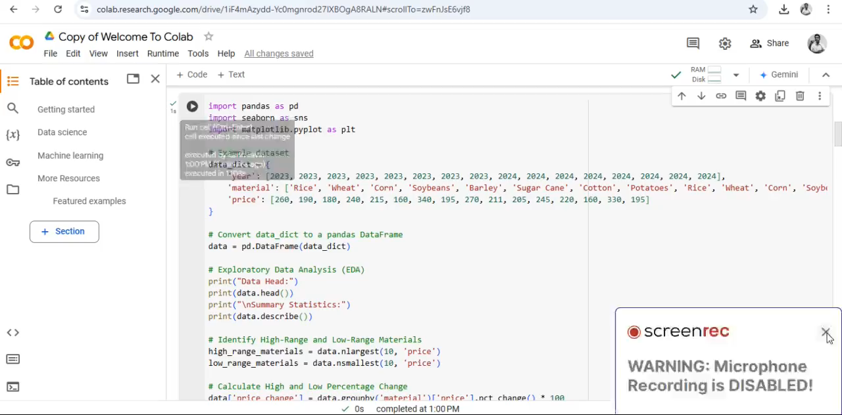
Video of the Project
Notes:
13

Slide 14
Conclusion
In summary, this project has successfully analyzed agricultural raw material prices, uncovering trends, fluctuations, and correlations. The identification of high and low-range materials, coupled with percentage change analysis, provides valuable insights for stakeholders. Additionally, the exploration of price dynamics over the years offers a comprehensive understanding of market trends. The development of predictive models opens doors for forecasting future prices, aiding in strategic decision-making. Moving forward, integrating real-time data and refining models can further enhance predictive accuracy. Overall, this project serves as a valuable tool for stakeholders navigating the agricultural market, offering actionable insights to optimize investment strategies and mitigate risks.
Notes:
14

Slide 15
Reference
https://pandas.pydata.org/docs/
https://seaborn.pydata.org/tutorial.html
https://seaborn.pydata.org/examples/index.html
https://pandas.pydata.org/docs/
https://machinelearningmastery.com/time-series-forecasting/
https://en.wikipedia.org/wiki/Correlation
Notes:
Reference
These are the references for this session.

Slide 16
Thank you
Notes:
16

